Slide 1

ALY 6080 Integrated Experiential Learn XN Final Project June 23,2020
By GROUP 5
POORNIMA MURALIDHARAN
CHIRAG SHAH
LIXUAN FENG
MANAS A PAWAR
SANGEETA RAMRAKHYANI

Slide 2
Introduction
The Sponsor of this project is an Assessment group of CPS in Northeastern University.
Data provided contains skills one can acquire from the 45 Courses in 3 CPS Programs – LDR, SLDR and PJM
Objective of this project
-Map the course skill to that of the job skills.
- Create a dashboard for students/faculties to view professional skills
- Final Output can help students choose the required course.
Initial Analysis
Data Cleaning – Check Null values/missing values
Data reshaping – How & Why?
EDA – Tool used and interpretation of patterns/graphs
Data Cleaning
Data Reshaping
Exploratory Data Analysis
Using Python
Using Python
Using Python & Tableau tools
Final Project - Interactive Dashboard for the use of Academic advisors and students

Slide 3
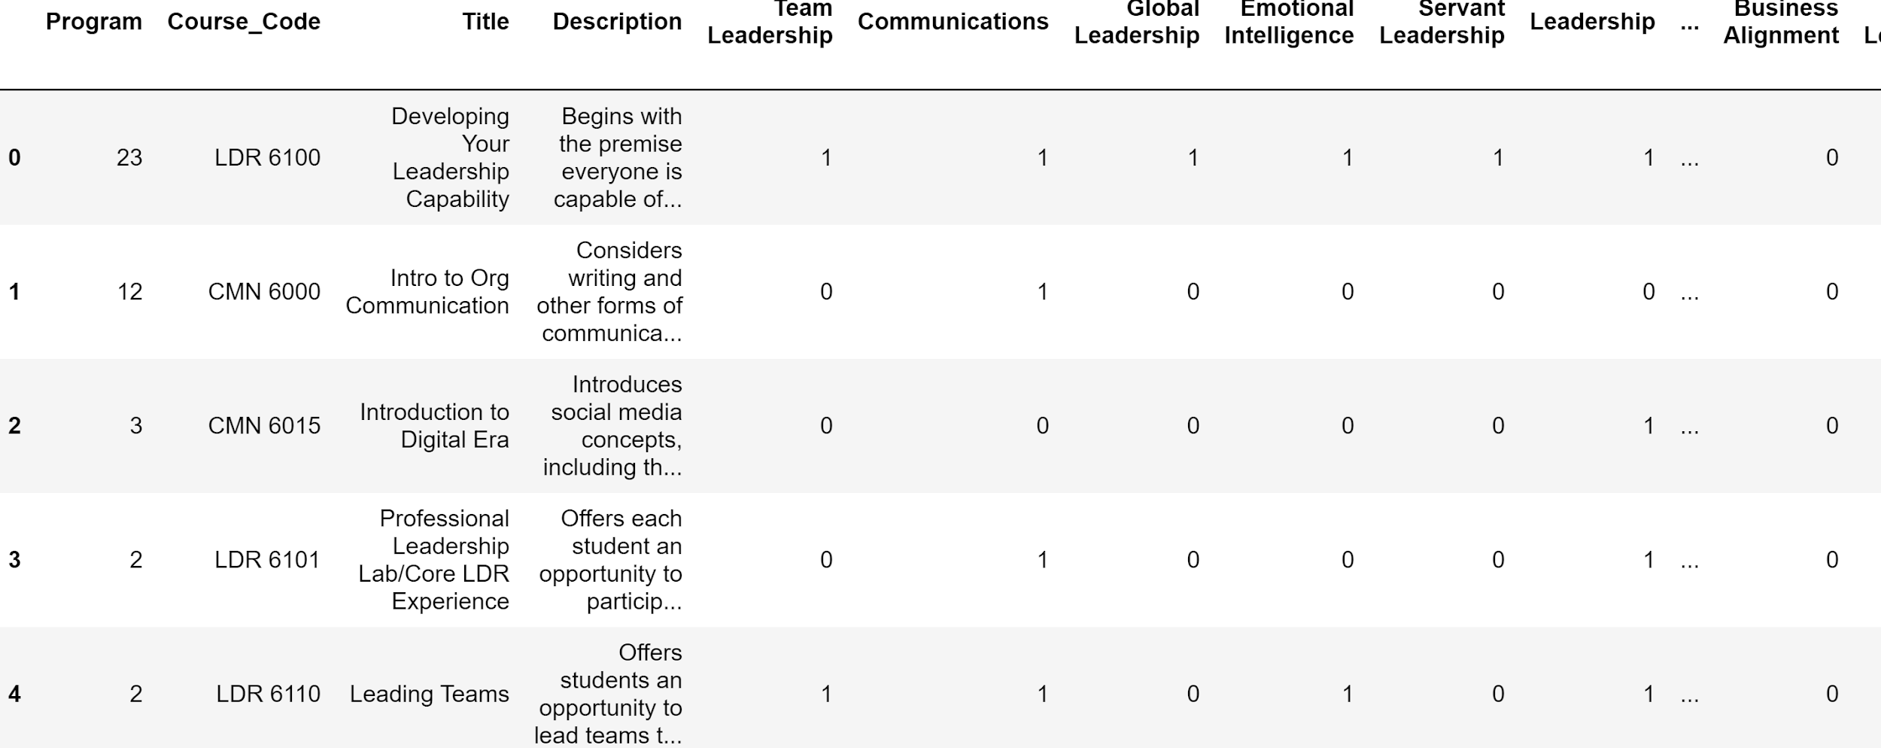
Data Preparation
Descriptive analysis of the dataset.
Data Reshaping
Binary encoding for the skills mentioned.
Program column was added to the primary dataset.
Secondary dataset was divided based on 3 programs.
For Tableau dashboard, we converted the skills column from wide format to long format based on the courses
Figure shows the dataset after doing data preparation

Slide 4
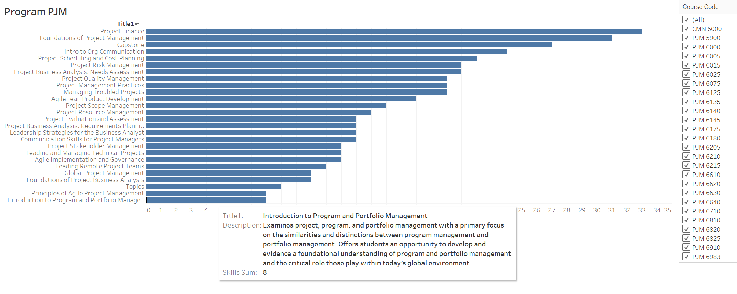
Skills Distributed in each Program
Tool : Tableau- A convenient tool for interactive dashboard
The three Bar graphs show the total skills in the courses for each program.
The Hover shows the Description of the course
Majority Skills offered:
- In PJM : Project Finance, Foundations of Project Management and Capstone
By Sangeeta Ramrakhyani

Slide 5
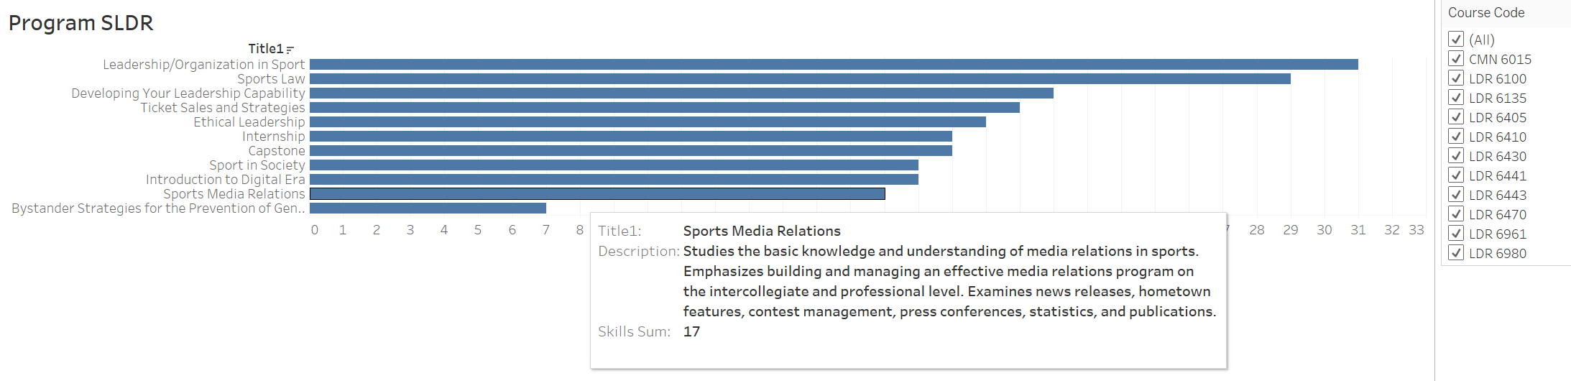
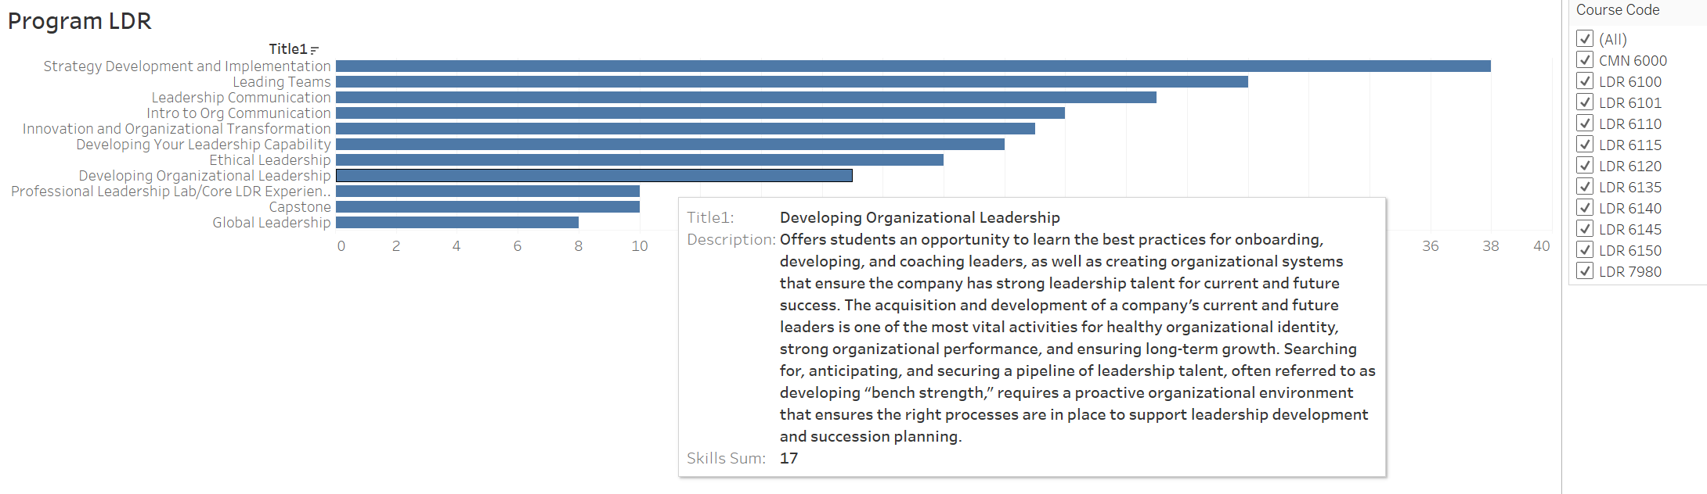
- In SLDR : Leadership/Organization in Sport, Sports Law & Developing Leadership Capability.
- In LDR : Strategy Development & Implementation, Leading Teams & Leadership Communication

Slide 6
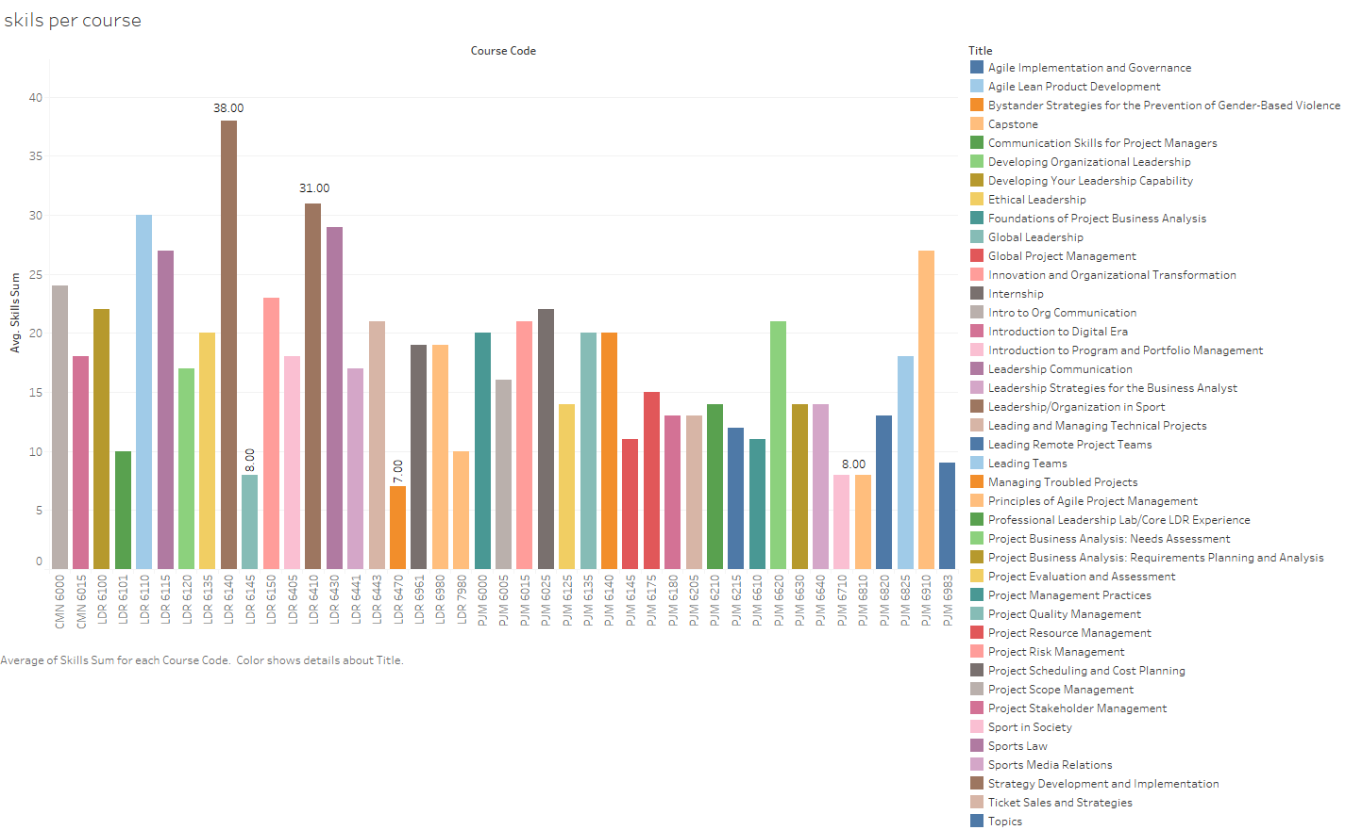
Skills per course & course outcomes per program
Tool : Tableau
Tableau helps in hovering around the graphs that help in noting each detail of the data.
The Bar graph shows the total skills in each course.
Max skills - LDR 6140 Strategy Development and Implementation
Least skills - LDR 6470 Bystander Strategies for the prevention of gender based violence
Courses need to be designed such that it covers all the skills.
By Manas A Pawar

Slide 7
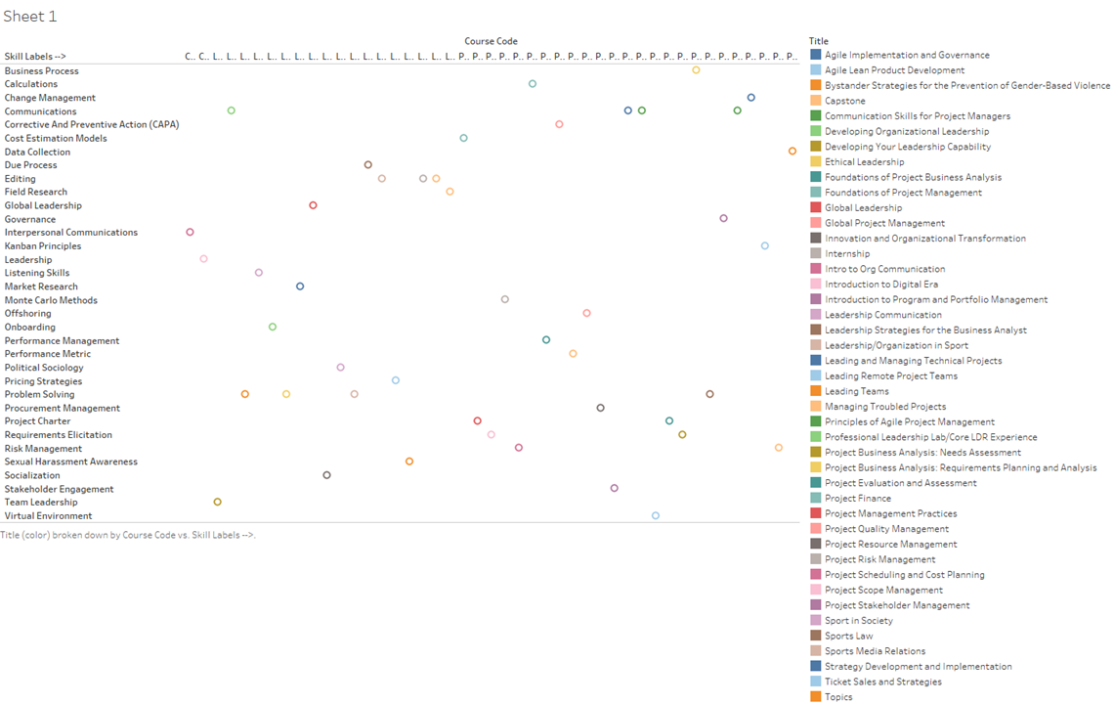
The plot shows the skills with respect to the program titles and is segregated as per the course.
User can access this graph to hover around
By Manas A Pawar

Slide 8
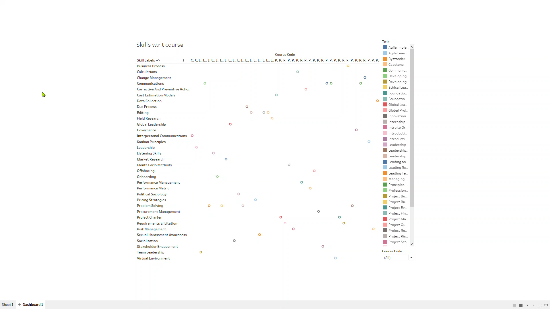

Slide 9
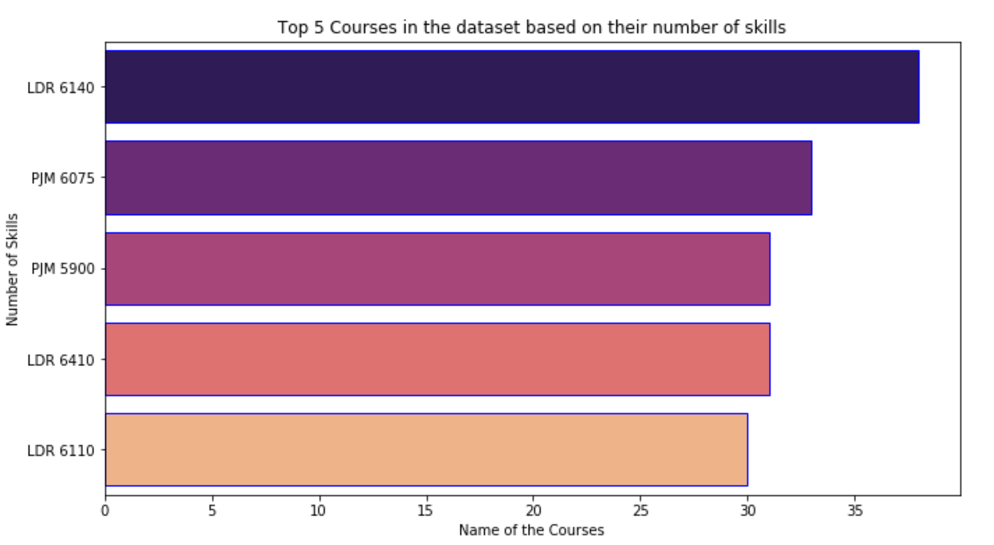
Top 5 Course Skills and competencies
Tool: Python
Python has Seaborn library with different palette’s and styles.
Line chart describes the top five course skills.
These skills are calculated based on the skill sum.
By Chirag Shah

Slide 10
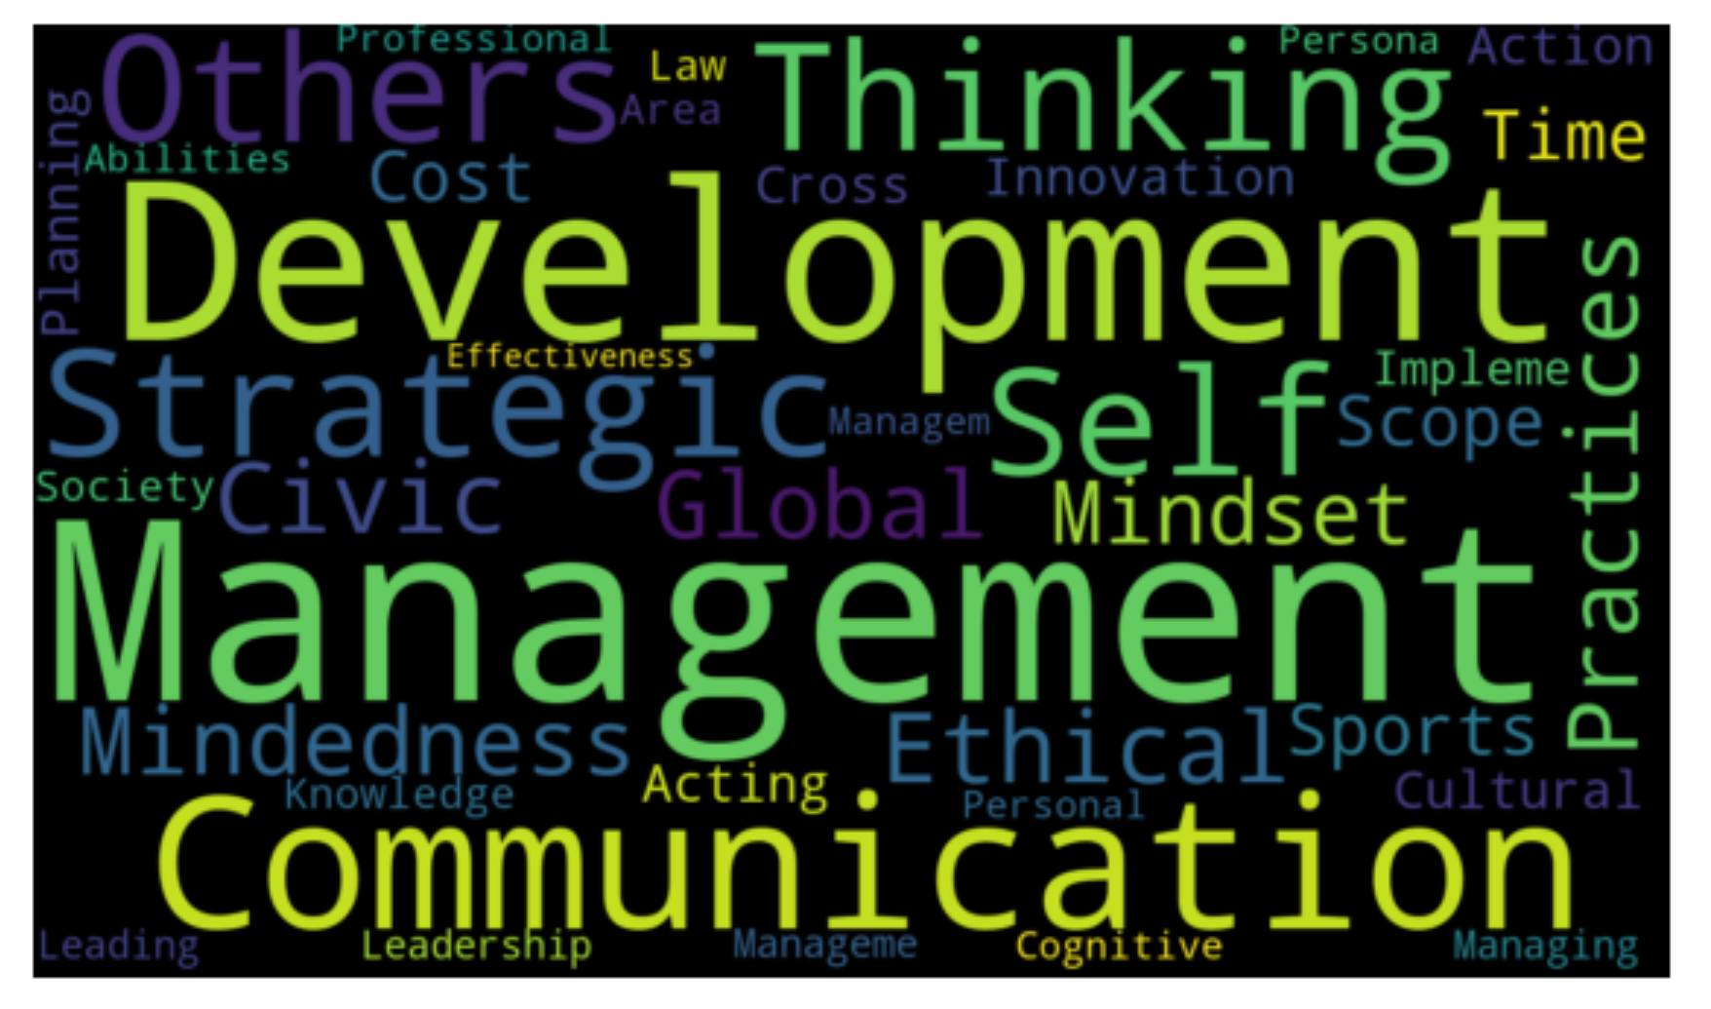
Associated Competencies
The Word Cloud graph describes the top associated competencies for all the programs.
Management and Development are the top competencies.
By Chirag Shah

Slide 11
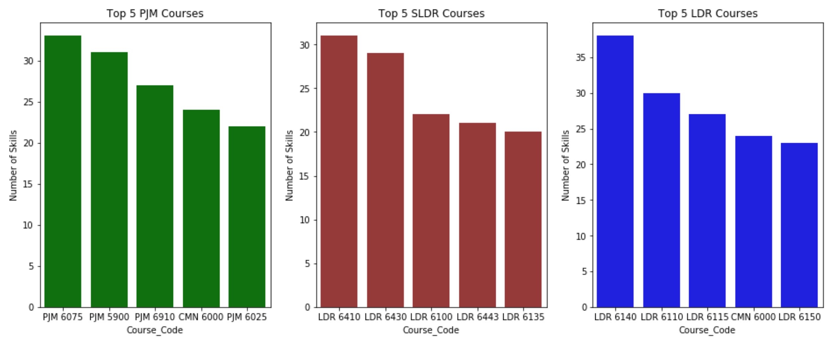
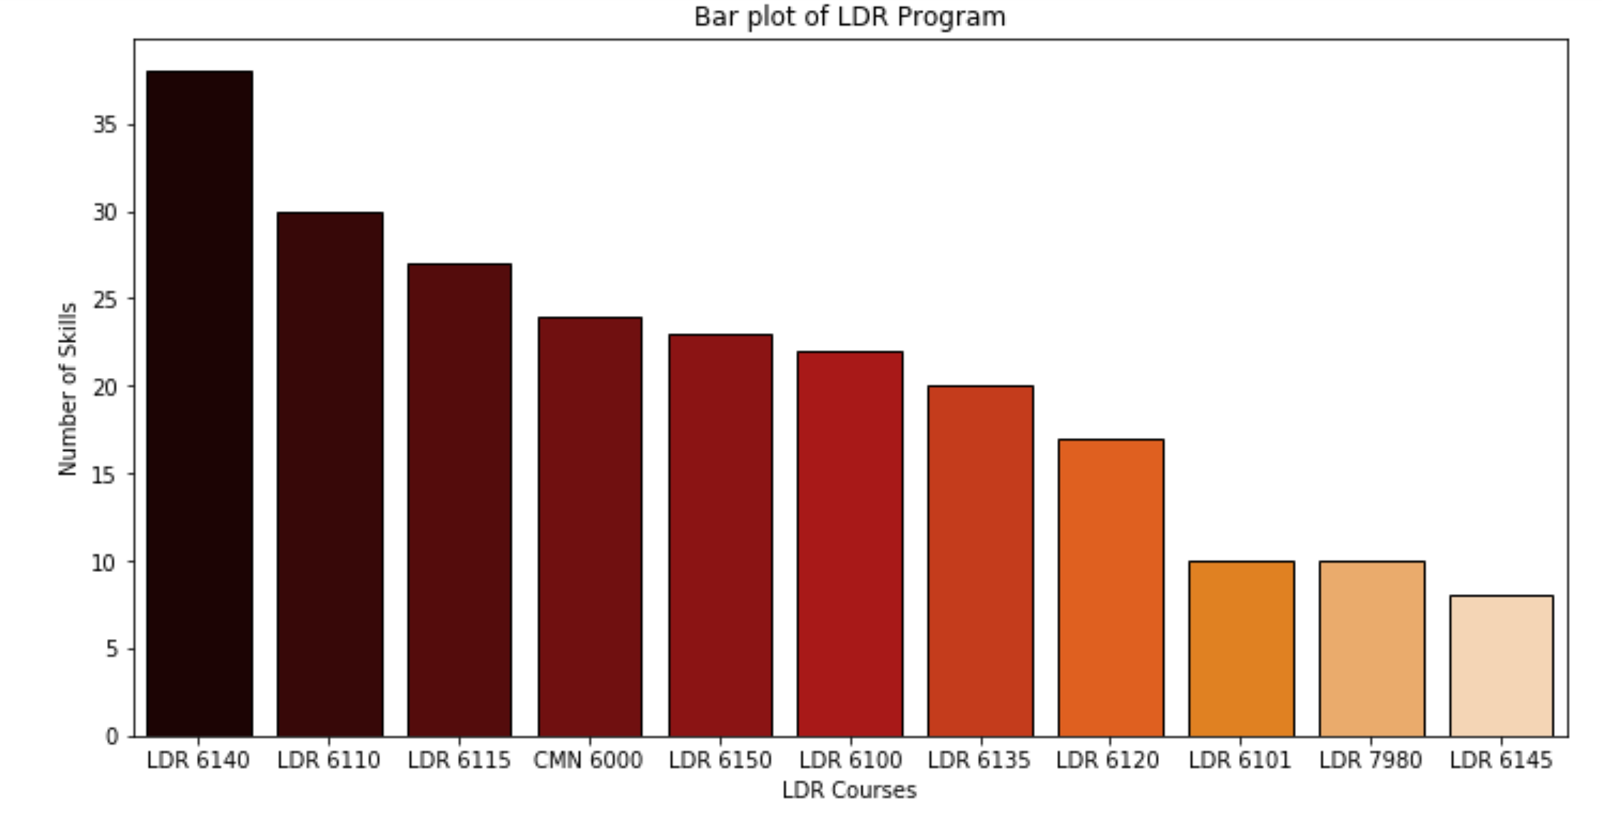
Top 5 Program Skills and
LDR course skills
Each Bar chart shows the top 5 skills based on the three programs.
PJM and LDR are both offering CMN6000 course.
The scatter plot of LDR Program shows the variation of number of skills in LDR program.
There are more LDR courses with skills between 15 to 30 range.
There are 11 LDR courses which is offered by LDR Program.
By Chirag Shah

Slide 12
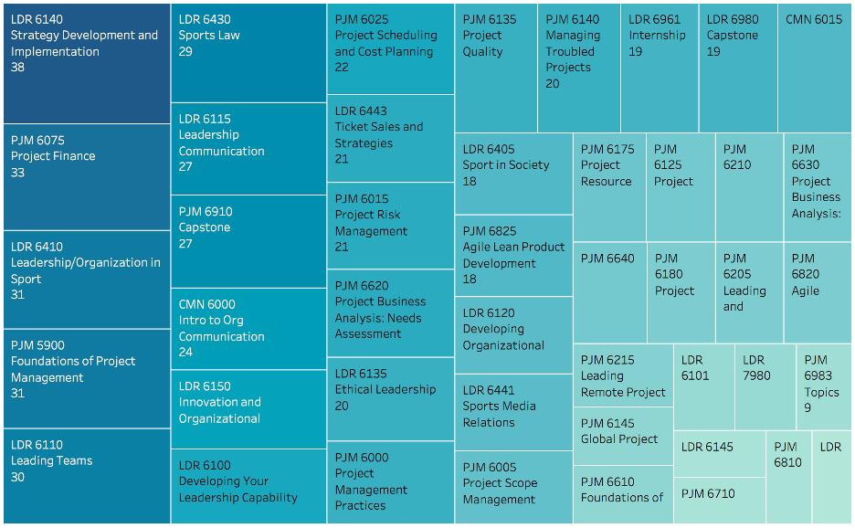
Overview course skills
21 courses of them have involved over 18 skills
7 courses involved less or equal 10 skills
By Lixuan Feng

Slide 13
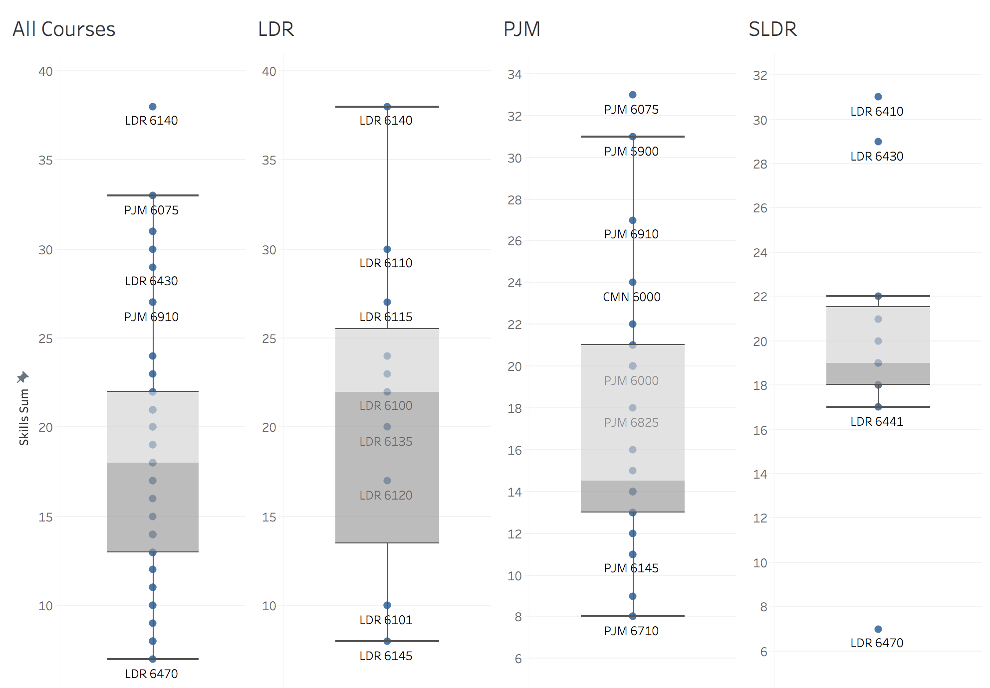
Course skills Outlier
LDR 6140 (LDR) Strategy
Development and Implementation
PJM 6075 (PJM) Project Finance
Outliers
(SLDR)
LDR 6410, Leadership/Organization
in Sport
LDR 6430
Sports Law
LDR 6470
Bystander Strategies for
the Prevention of
Gender-Based Violence
Upper whisker
Upper hinge
Median
Lower hinge
lower whisker
By Lixuan Feng

Slide 14
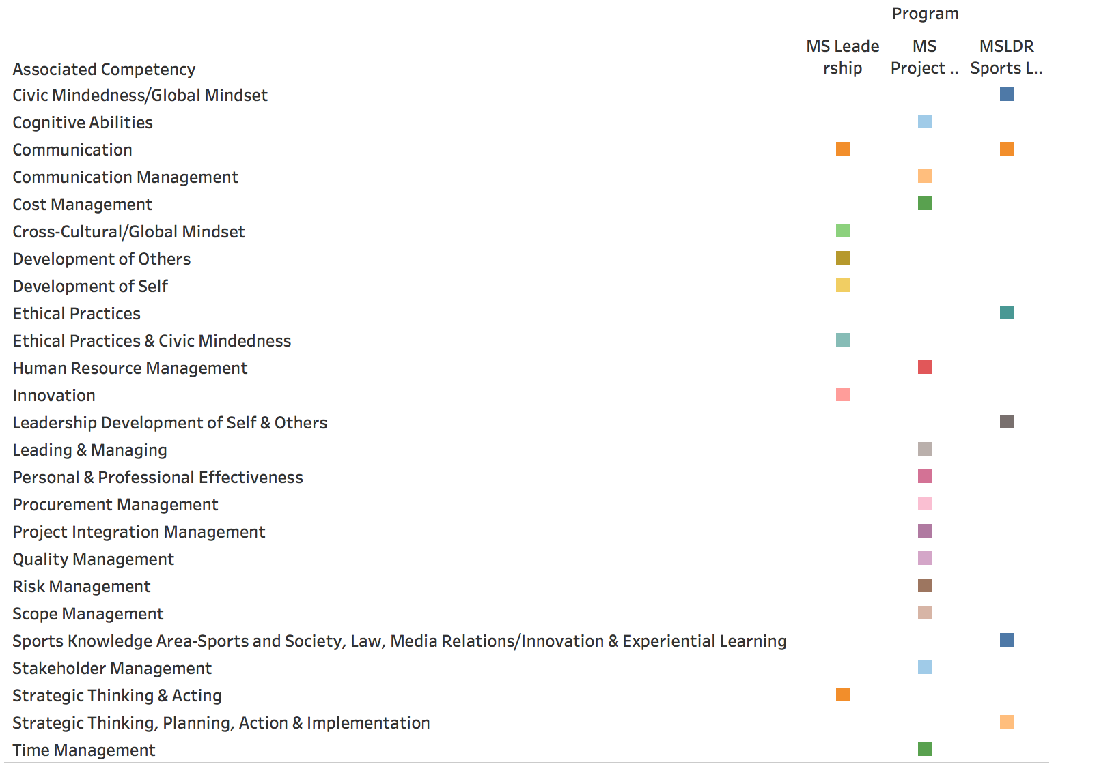
Associated competency
Number of associated competency per program:
LDR: 7
PJM: 13
SLDR: 6
Overlap associated competency:
Communication Management
By Lixuan Feng

Slide 15
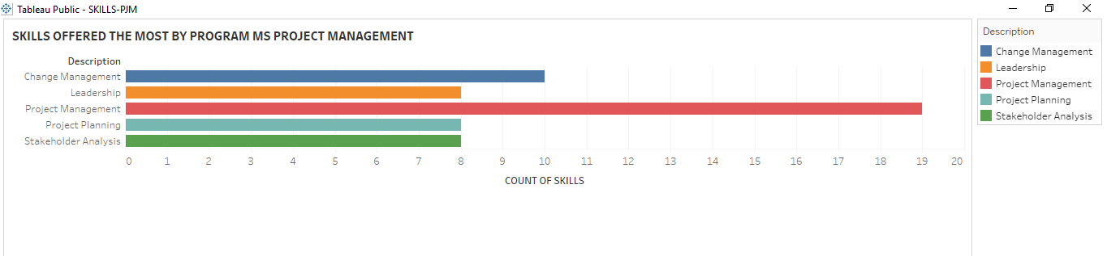
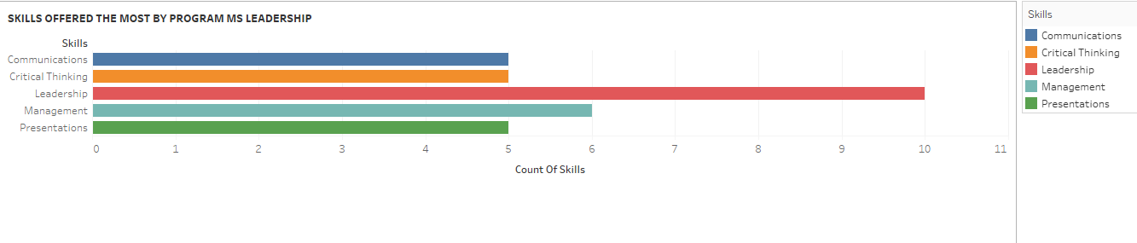
Most skills offered by each program
Clustered bar graph that shows skills which are obtained after learning the respective course in each program.
These are the most offered skills in each program
MS PJM has 26 courses.
Top skills provided by PJM are Change management, Leadership, Project Management, Project Planning, Stakeholder Analysis.
MS leadership has 11 courses.
Top skills provided are Communication, Critical thinking, Leadership, Management, Presentations
By Poornima Muralidharan

Slide 16
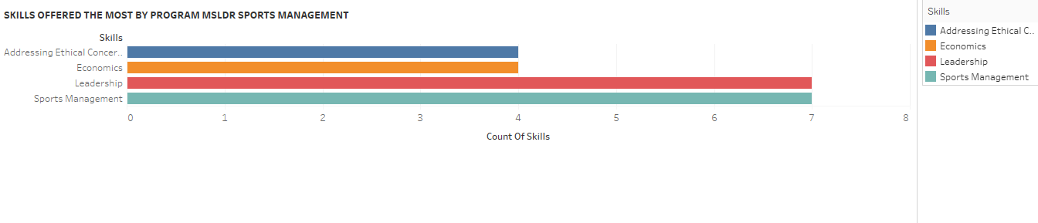
MS LDR Sports program has 11 courses
Top skills provided are Addressing Ethical Concerns, Economics, Leadership, Sports Management.
Leadership is the common skill provided by all three programs.

Slide 17
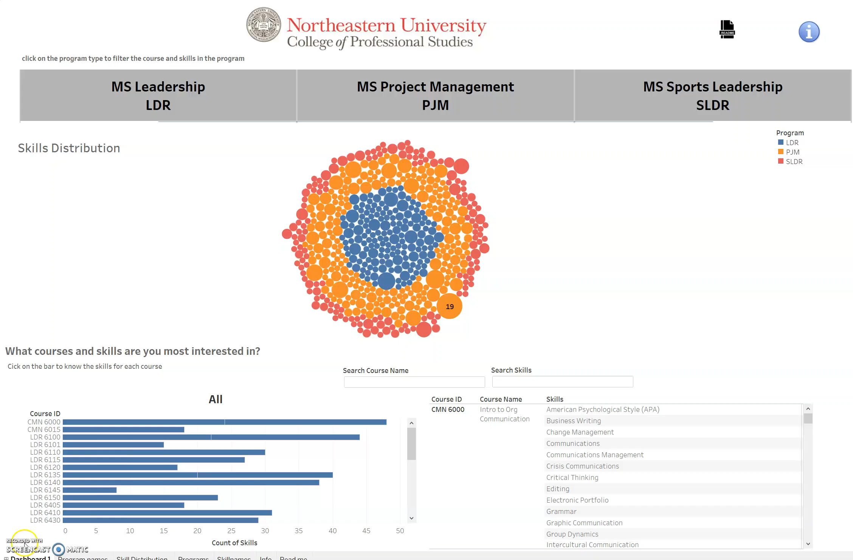

Slide 18

Conclusion
The data contains skills of 45 courses in 3 CPS programs
Analysis was easier after binary encoding of the data with 413 columns.
A total of 21 courses offer about 18 skills to the students.
LDR6140 in LDR program provide the highest number of skills, whereas LDR6470 in SLDR Program offer the lowest number of skills.
Management is the top associated competency offered by the program.
PJM program courses offers highest number of skills among all three programs.
Leadership skill is offered by most of the courses by MS Leadership and SLDR Programs.
MS Leadership program has more Student learning outcomes.
Project Outcome: The Interactive dashboard can be used with ease by academic advisors to view the courses based on skills of interest.

Slide 19
Acknowledgements
Data Preparation
Chirag Shah
Analysis
Poornima Muralidharan
Sangeeta Ramrakhyani
Chirag Shah
Lixuan Feng
Manas A Pawar
Slide Preparation
Sangeeta Ramrakhyani
Presentation
Team Contribution
Feng, Lixuan: feng.lix@husky.neu.edu
Muralidharan, Poornima: muralidharan.p@husky.neu.edu
Pawar, Manas: pawar.m@husky.neu.edu
Ramrakhyani, Sangeeta: ramrakhyani.s@husky.neu.edu
Shah, Chirag: shah.chir@northeastern.edu
Contact

